Slide 1
Heads Up Display System
Under the guidance of
Nandhini Vineeth
Project By
Meghana Kiran 1BM12CS056
Mukul Raj 1BM12CS059
Saajan Tikare 1BM12CS098
Shamanth Jagadish Manakame 1BM12CS103

Slide 2
Motivation
Attempt a Human Assistive Technology Implementation
Wearable computing – On the go computing
Customization of product – Use only what YOU want

Slide 3
Objectives
A Heads Up Display System targeted towards the adventure community
Providing a Heads up Display using a LCD Interface which displays attributes such as Temperature, Humidity and GPS positions
Helps in giving timely information to the device user

Slide 4
Components
Hardware
Raspberry Pi 2 Model B
DHT11 Sensor
Ultrasonic Sensor
GPS Module
LCD Display
Software
Raspbian Jesse NOOBS
Python
GPS Drivers
Library for DHT
Library for LCD Display

Slide 5
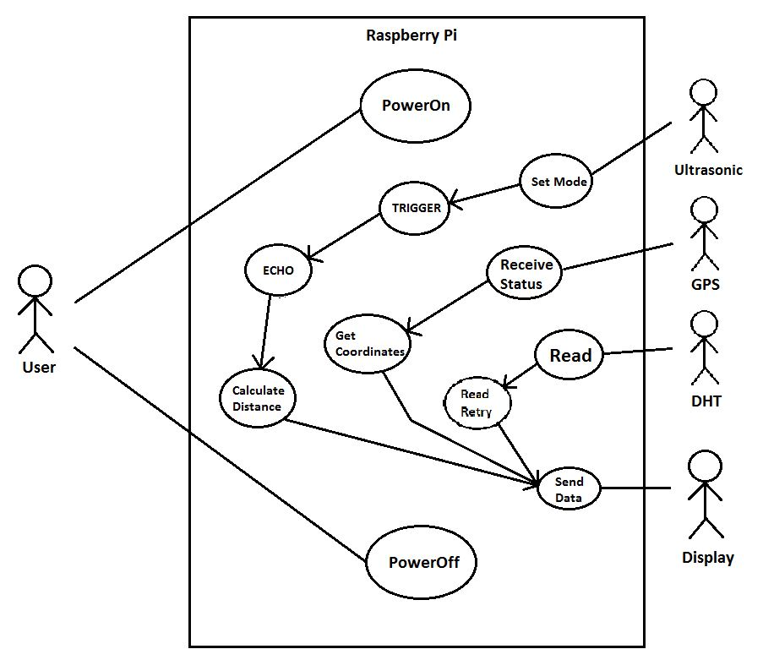
Use Case Diagram

Slide 6
IMPLEMENTATION
Modules and their Compilation

Slide 7
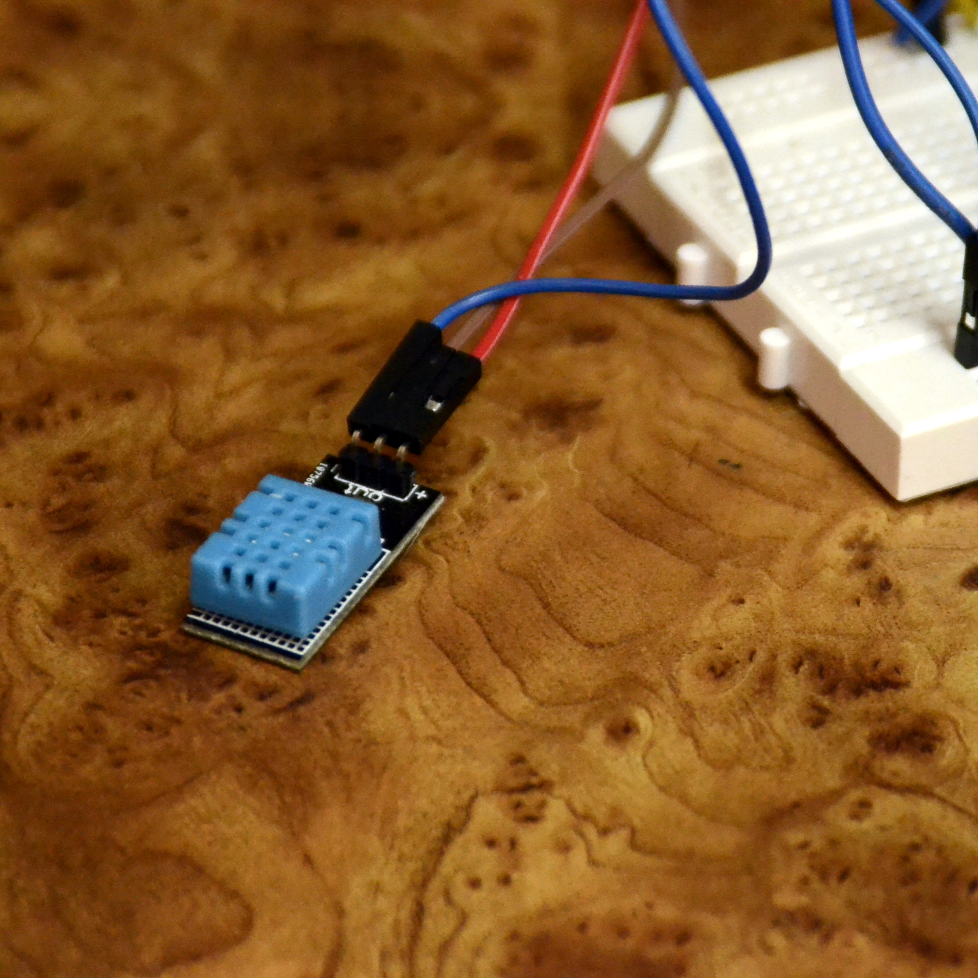
DHT11
Sensor used to measure the surrounding Temperature and Humidity.
Generally used with a 10kΩ resister to prevent the sensor from burning out.
Can be used with a Raspberry Pi directly as well

Slide 8
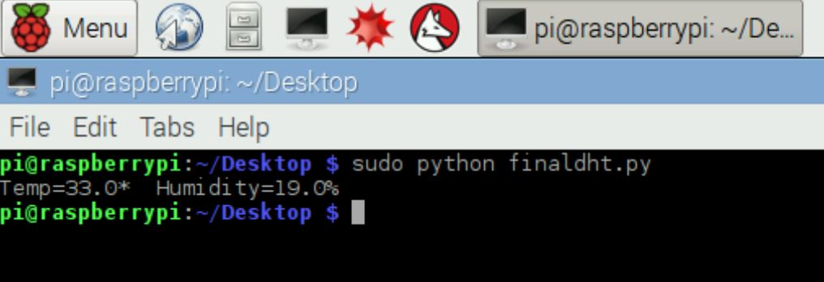
DHT11
humidity,temperature=DHT.read_retry(sensor,pin)
If humidity is not None and temperature is not None:
print ‘Temp={0:0.1f}* Humidity={1:0.1f}%’.format(temperature,humidity)
else:
print ‘Failed to get reading. Try again’

Slide 9
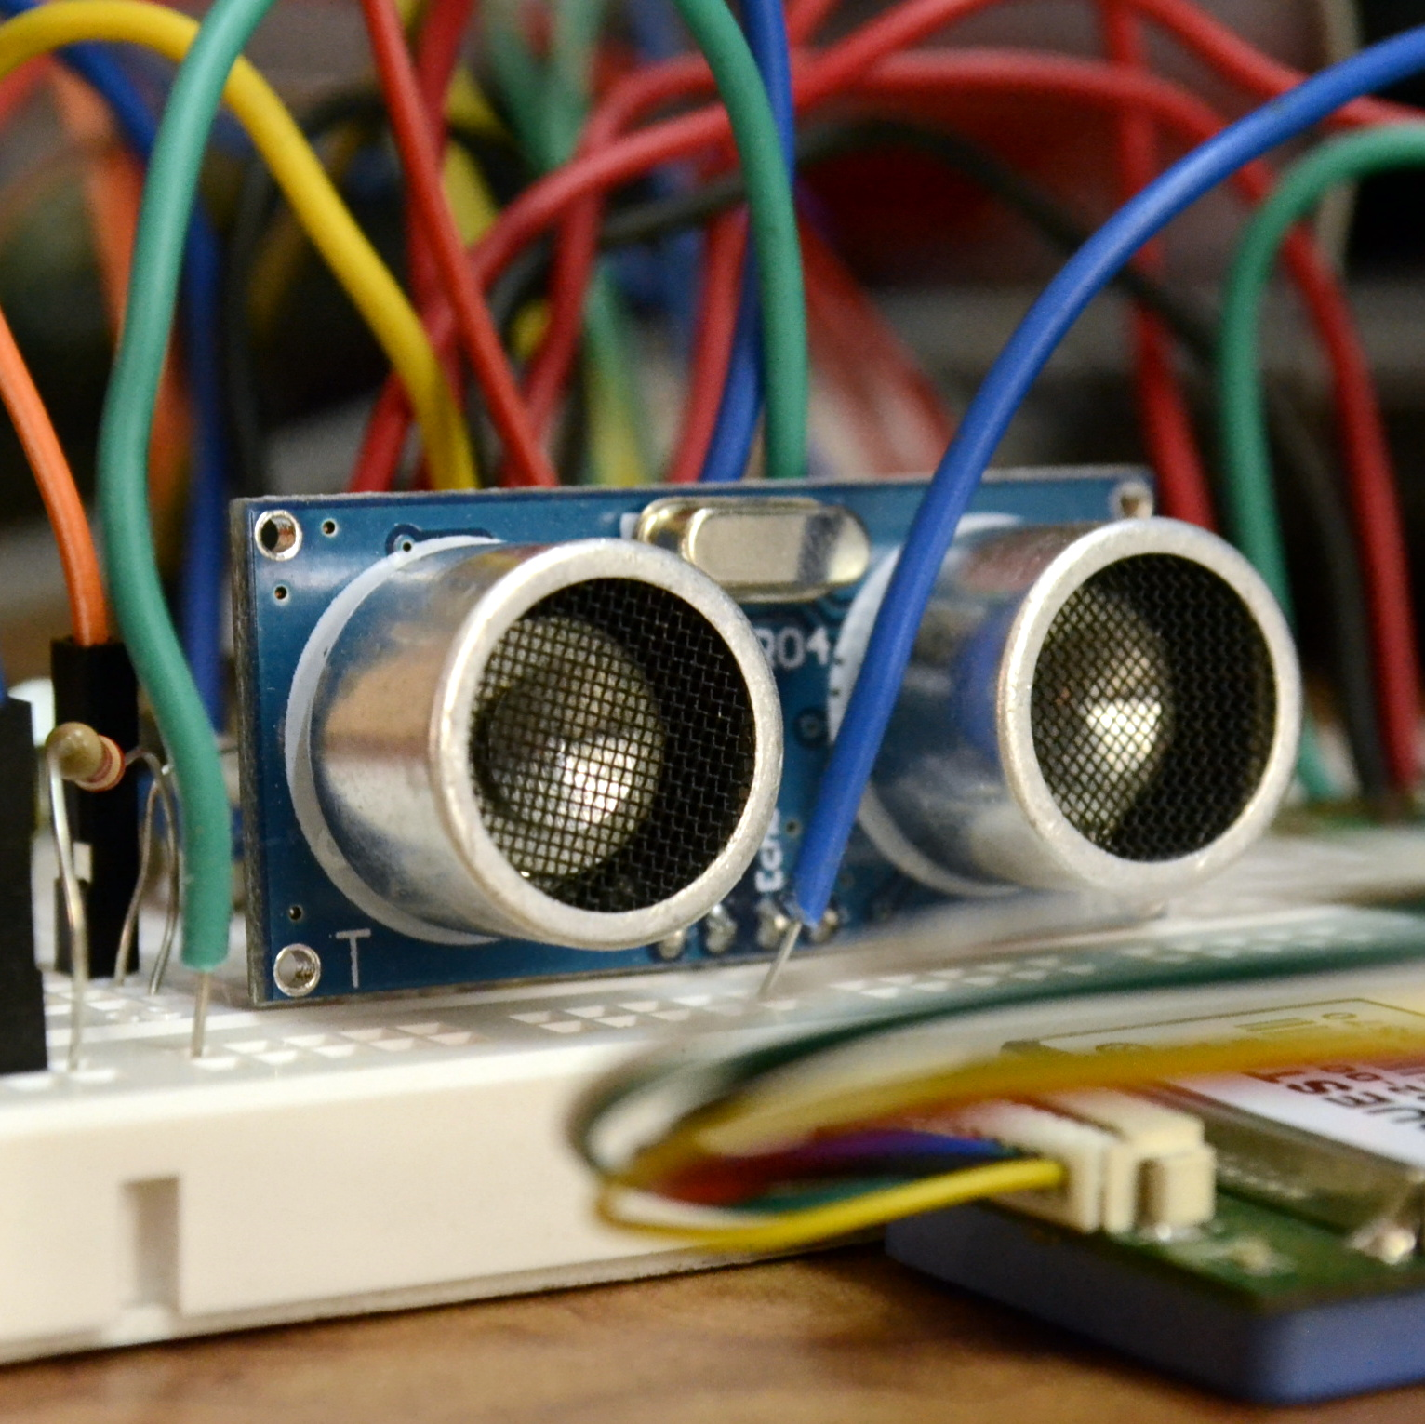
Ultrasonic Sensor
Used generally as a proximity sensor
Uses TRIGGER signal to send an ultrasonic wave into the surrounding environment. The wave bounces off back from an obstacle. The ECHO signal receives the ultrasonic wave
The distance between the module and obstacle is calculated by measuring the time difference between the TRIGGER AND ECHO signals

Slide 10
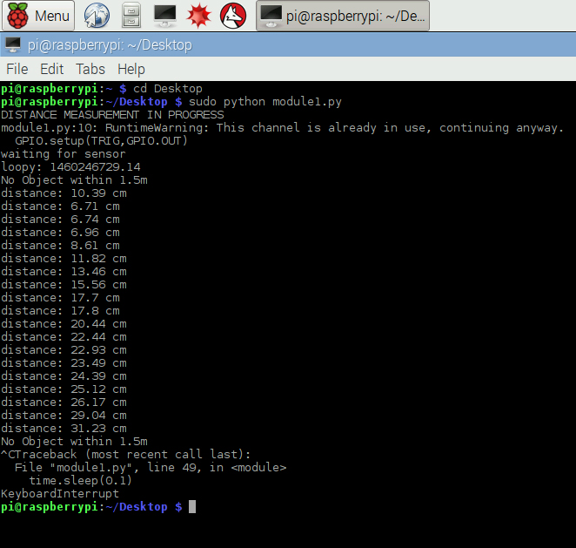
Ultrasonic Sensor
GPIO.output(TRIG,TRUE)
Sleep(0.0001)
GPIO.output(TRIG,FALSE)
While GPIO.input(ECHO)==0:
sonic_start=time.time()
While GPIO.inout(ECHO)==1
sonic_end==time.time()
Ultraduration=sonic_end-sonic_start
Distance=ultraduration*17150

Slide 11
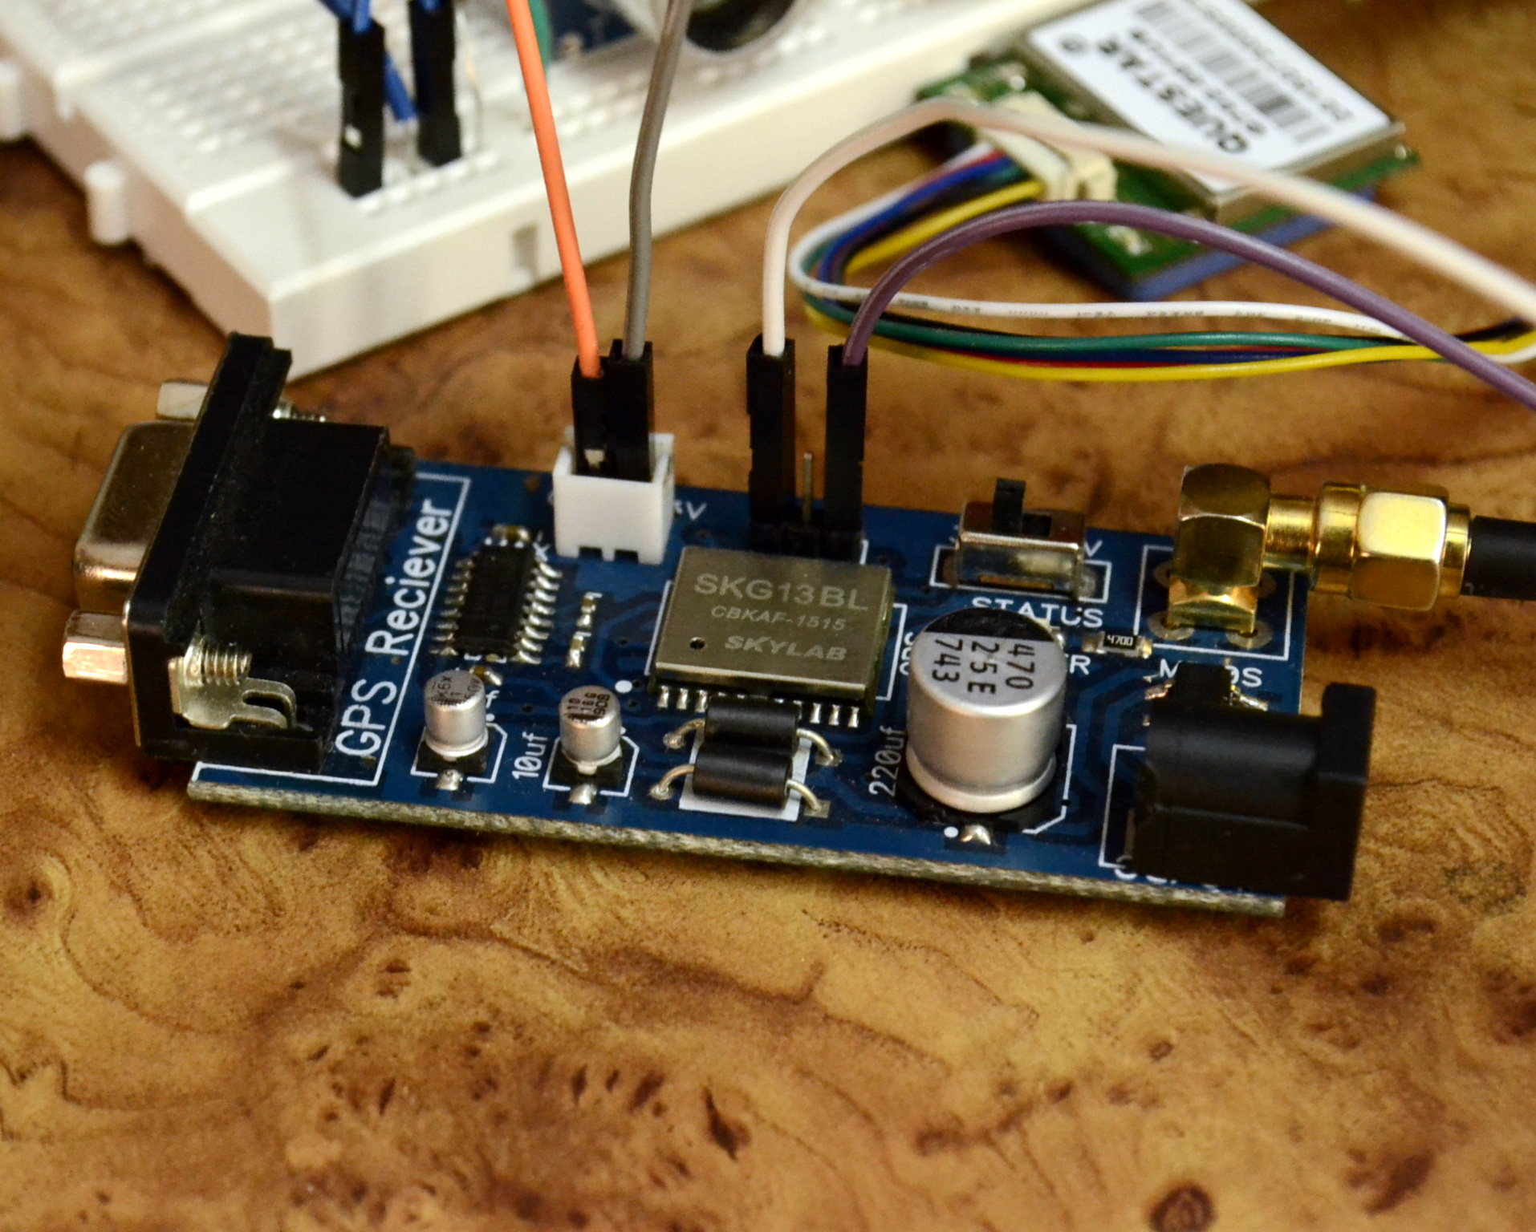
GPS Sensor
Connects to a minimum of 3 GPS satellites and provides latitude, longitude, GMT time, date
Always used along with an antenna for better reception and faster satellite locking

Slide 12
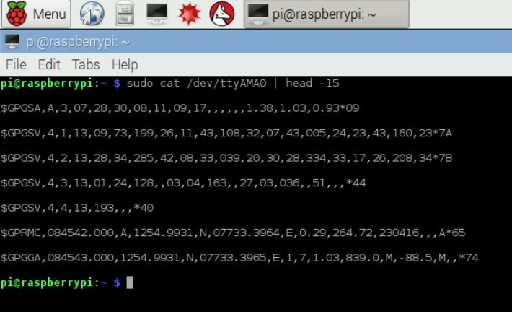
GPS Sensor
While true;
do sudo cat /dev/ttyAMA0 | head -15 > gpsfile1.txt;
grep –oP ‘GPMC.*’ gpsfile1.txt gpsfile2.txt;
Done
For line in f.readlines()
Parts=line.split(“,”)
For part in parts
a.insert(part)
B=a[3]
C=a[5]
D=a[9]

Slide 13
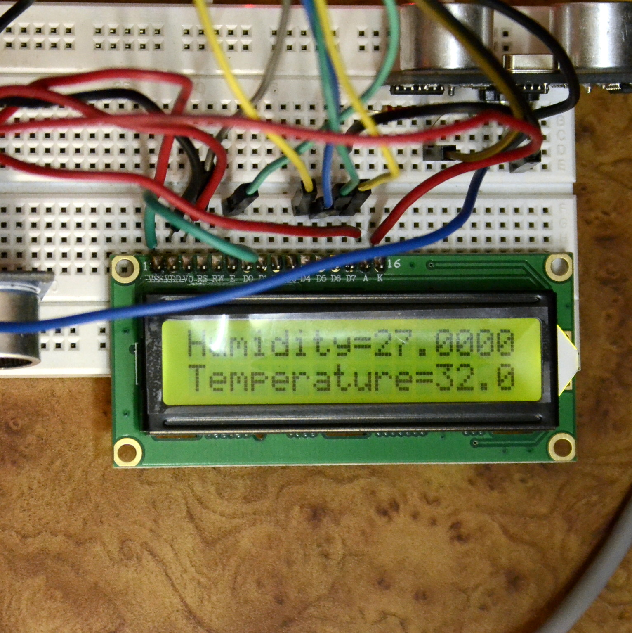
LCD Display
The product used is a 16x2 LCD display that displays characters from a-zA-Z0-9 and special characters
Potentiometers are used in order to set the contrast of the text and the brightness of the screen
It is the a device in the setup that uses 5v power supply. This is because we can change the contrast of the text and backlight display by using only 5v and not 3v.

Slide 14
The Compilation
The compilation of all the modules – Done on a small 17x5 bread board for prototype stage
Fabrication of PCB will reduce the number of connections done by wires and the entire circuit into 1”x1” PCB which is very small to put anywhere in the user’s helmet
The compiled code is run as a shell script and ran along with the booting process of the RPi
The final code imports required data sets for different modules and runs them all together in a single file and sends its output to the LCD display
The modules are connected to the RPi GPIO headers such that no 2 devices access the same GPIO in order to nullify the clashing of data signals

Slide 15
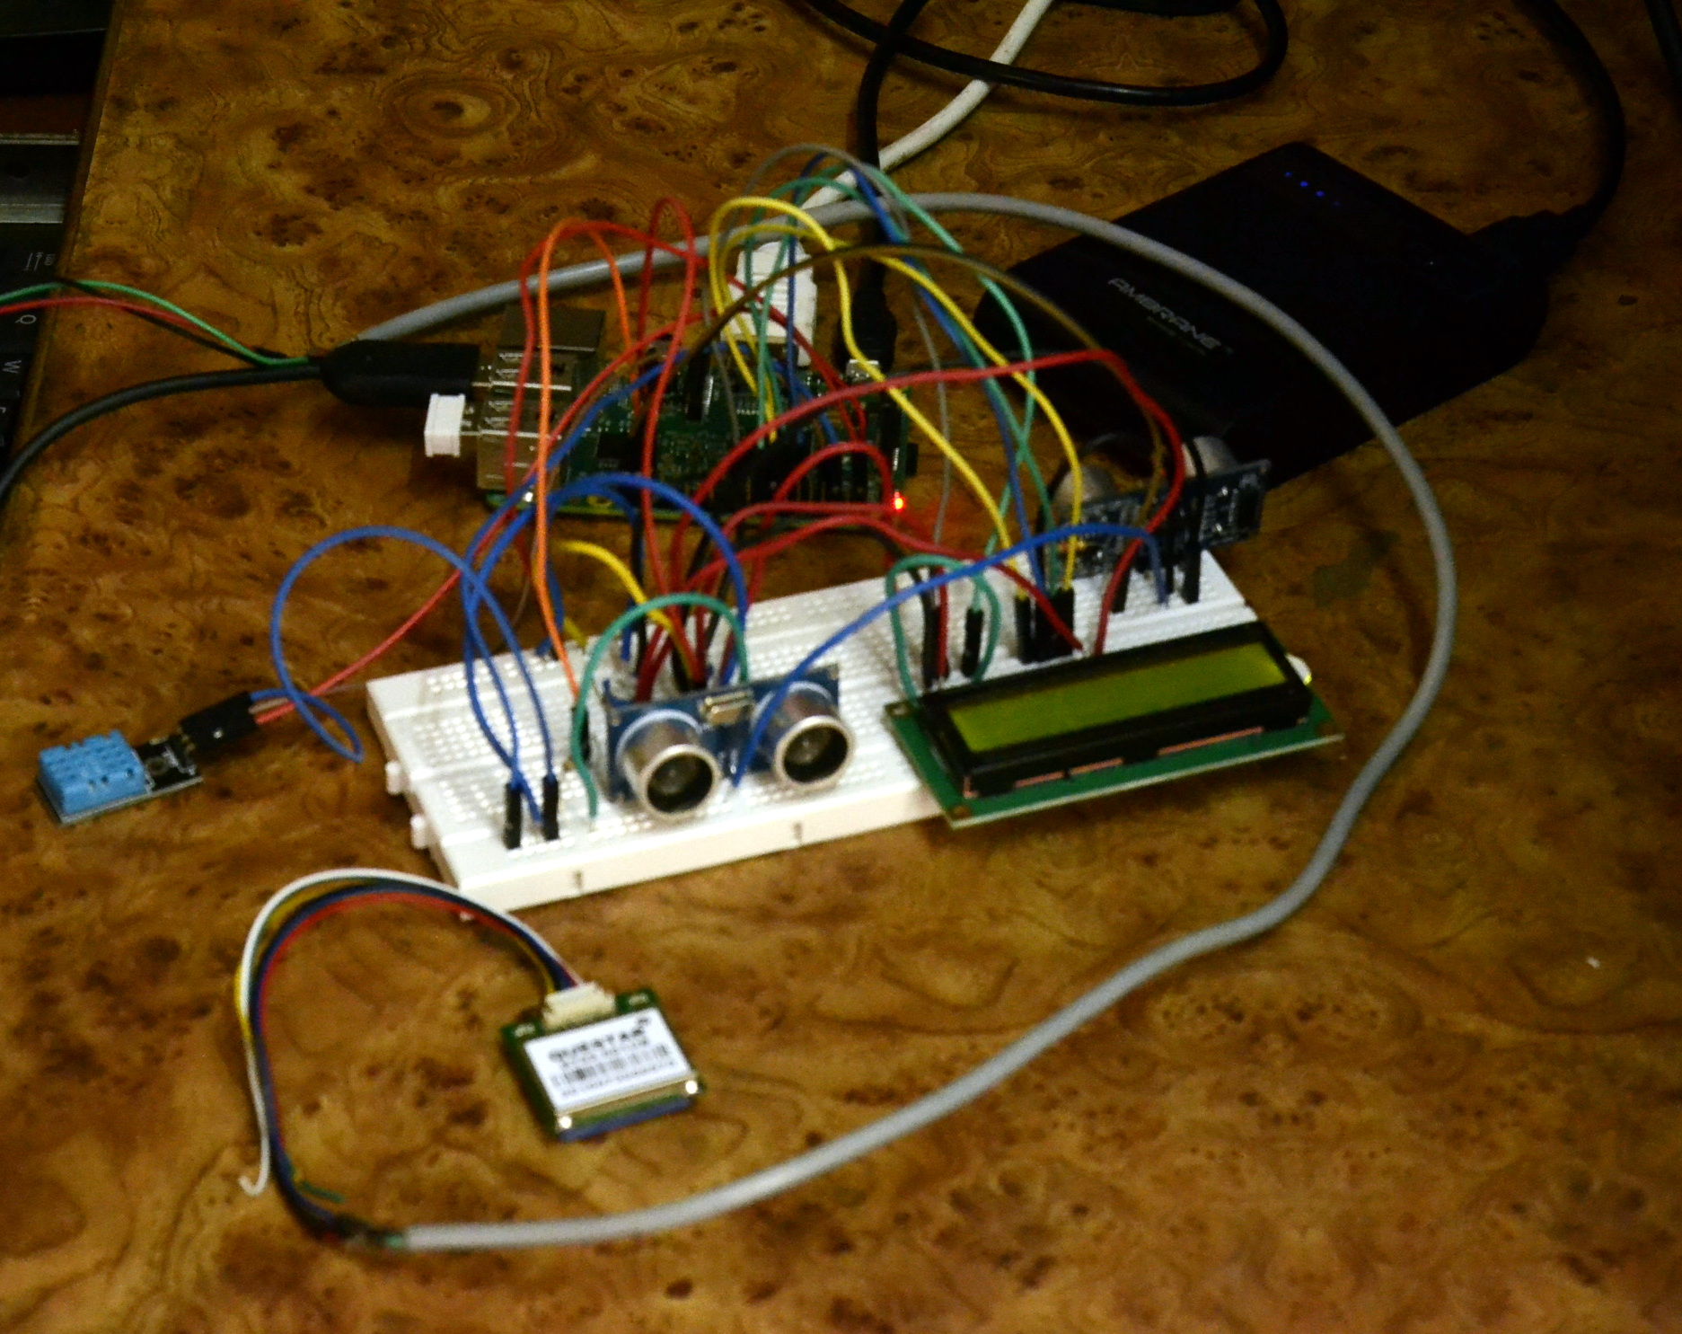
Components
DHT11
GPS
Display
2xUltrasonic sensors
Power Bank

Slide 16
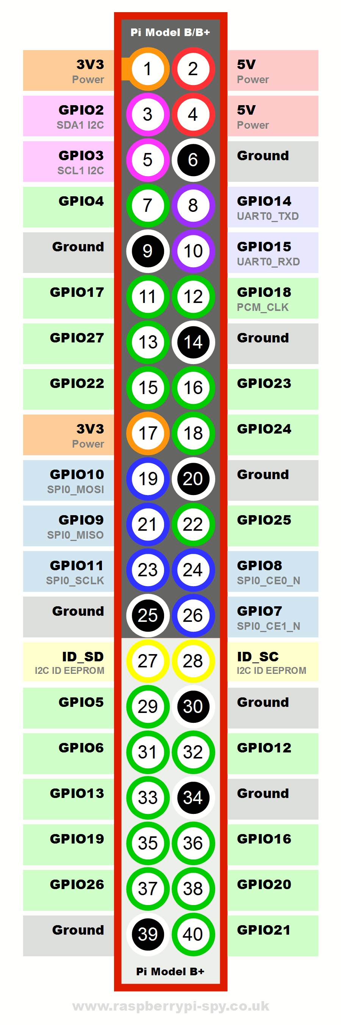
Pin Diagram of Raspberry Pi
Pin Number | GPIO Address | Usage
7 | 4 | DHT Sensor
10 | 15 | GPS Reciever
11, 13, 15, 16 | 17, 27, 22, 23 | Data lines for LCD
18, 22 | 24, 25 | Control lines for LCD
35, 37 | 19 TRIG, 26 ECHO | Ultrasonic Sensor
38, 40 | 20 TRIG, 21 ECHO | Ultrasonic Sensor

Slide 17
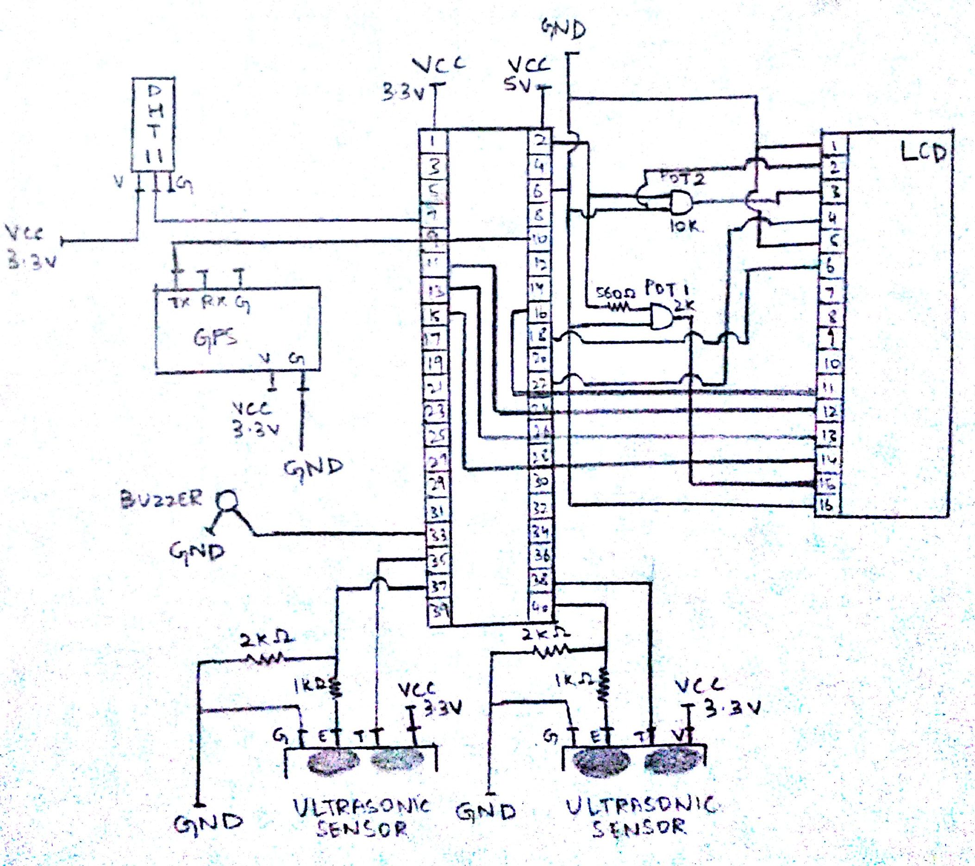
Circuit Diagram

Slide 18
CONCLUSION
Built at a total cost of ₹7500 at the prototype level making it one of the cheapest wearable HUD system
Can be further personalized with respect to user’s interest
PCB design will make the device look aesthetic and reduce size of the entire wearable system by a lot

Slide 19
Thank you

